Slide 1
GL18 (R) – Impurities: Residual Solvents in New Veterinary Medicinal Products, Active Substance and Excipients

Slide 2
Quality Guidelines on impurities
GL 18 is one of the guidelines which belongs to the group of guidelines dealing with impurities:
GL10 (R) – Impurities in New Veterinary Drug Substances
GL11 (R) - Impurities in New Veterinary Medicinal Products
GL18 (R) – Impurities – Residual Solvents in New Veterinary Medicinal Products, Active Substance and Excipients

Slide 3
Table of contents
Introduction
Scope
Analytical Methods
Principle
  Class 1 Solvents
  Class 2 Solvents
  Class 3 Solvents
Options for Class 2 Solvents
Options for Class 3 Solvents
Table 4: Solvents for which no adequate Toxicological Data was found
Residual Solvents Assessment – Flow Chart

Slide 4
Introduction
The objective of GL18 is to recommend acceptable amounts of residual solvents in pharmaceuticals for the safety of target animal and residues in food animals.
There is no safe residual solvent level and so all should be removed to the “maximum extent possible”
GL18 defines recommend limits based on safety data
Guideline is also copied verbatim to Ph.Eur. (5.4) and USP
Based on human health assumptions which are extrapolated to vet medicines

Slide 5
Scope of GL18
Applies to new VMPs, active substances and excipients
Also applies to VMPs containing existing active substances
  See EMEA/CVMP/423/01-FINAL (May 2001)
Does not apply to:
  Solvents used as excipients
    IPA limited to 50mg/day as residual solvent but can be 70% as solvent in VMP
  Solvents generated as degradation products such as acetic acid from acetates
    These are controlled as impurities and related substances

Slide 6
Analytical Methods
Residual solvents should be determined by validated analytical method.
Method is usually gas chromatography but other analytical procedure can be justified
  Methods for determining solvents are described in Ph.Eur.
If only class 3 solvents are present non-specific method such as ‘loss on drying’ may be used if justified
  May need adjustment for high water content products

Slide 7
Principle
Uses ‘Permitted Daily Exposure’ (PDE) to set limits for residual solvents
Four types/classes of solvents are defined
  Class 1: to be avoided
    Known/suspected human carcinogens, environmental hazards
  Class 2: to be limited
    Non-genotoxic animal carcinogens, neurotoxicity, teratogenicity
  Class 3: low toxic potential
    Low potential toxicity in man
  Table 4 solvents:
    No adequate toxicological data available
    Often useful solvents which need further justification

Slide 8
Principle (next)
Class 1 solvents:
  Avoid if at all possible or reduce amount by processing
  Do not have PDE limits (unlike class 2 or 3 solvents)
  Limits are absolute ppm levels
  Provided in GL18 table 1
    benzene 2ppm, carbon tetrachloride 4ppm
    1,1,1-trichloroethane 1500ppm set as environmental not safety hazard
Be aware of benzene contamination risk
  Level of benzene in acetone and toluene needs to be considered and justified

Slide 9
Principle (next)
Class 2 solvents:
  Limit use wherever possible and/or reduce amount by processing
  PDE limits are provided in GL18 table 2 and based on safety data
    Acetonitrile 4.1 mg/day
    Hexane 2.9 mg/day…

Slide 10
Principle (next)
Class 3 solvents:
  Limit use wherever possible and/or reduce amount by processing
  PDE limits 50 mg/day for all class 3 solvents (GL18 table 3)
    Ethanol, isopropyl alcohol, acetone..(remember benzene contamination risk for acetone)

Slide 11
Options for Class 2 solvents
Option 1
  Assumption is that maximum daily dose of VMP is 10g
  If concentration limits for class 2 solvents are below values in table 2, then no further justification is needed
  However if class 2 limits are exceeded and daily dose is less than 10g then Option 2 is applied

Slide 12
Options for Class 2 solvents (next)
Option 2
  Amounts of class 2 solvents in each component (active substance and excipients) of the VMP are added together
  Maximum daily dose of the product is used to calculate exposure
    If exposure is less than PDE for each solvent then GL18 is met
    Important to assess worst case if product has multiple strengths and/or dose regimens
    If PDE exceeded then Option 3 can be used

Slide 13
Options for Class 2 solvents (next)
Option 3
  Justification can be made for higher levels than the PDE on a case-by-case basis:
    Correction for bodyweight of actual target species to recalculate actual PDE – 50kg human vs 450kg cow or 110kg pig.
    New toxicological data to allow new PDE to be calculated
    Steps to reduce level of solvent shown to be impracticable and Benefit-Risk assessment to support product with residual solvent at higher level.
      Dosage route: topical vs oral vs injection
      Once monthly vs daily dosing
      Product with higher safety risks due to other factors such as oncology VMPs.

Slide 14
Options for Class 3 solvents
Option 1
  If levels are less than 0.5% (5000 ppm) then no further justification needed
    Assumes daily dose of 10g
Option 2
  Use actual daily dose to justify on PDE of 50 mg/day (as for Class 2 solvents)
  Also manufacturing capability assessment to justify higher levels of class 3 solvents.

Slide 15
Solvents with no adequate toxicological data
Table 4: Solvents for which no adequate toxicological data was found
These are solvents which may be useful but for which there is insufficient safety data on which to base PDE
Example of Isopropyl ether present in Active Substance and hence VMP
  Safety (MSDS) provided and argument based on similarity to diethyl ether, a class 3 solvent
  Level of Active Subs in final VMP gave maximum exposure <0.03 mg/day cf ethyl ether 50mg/day
  Argument accepted by National Agencies

Slide 16
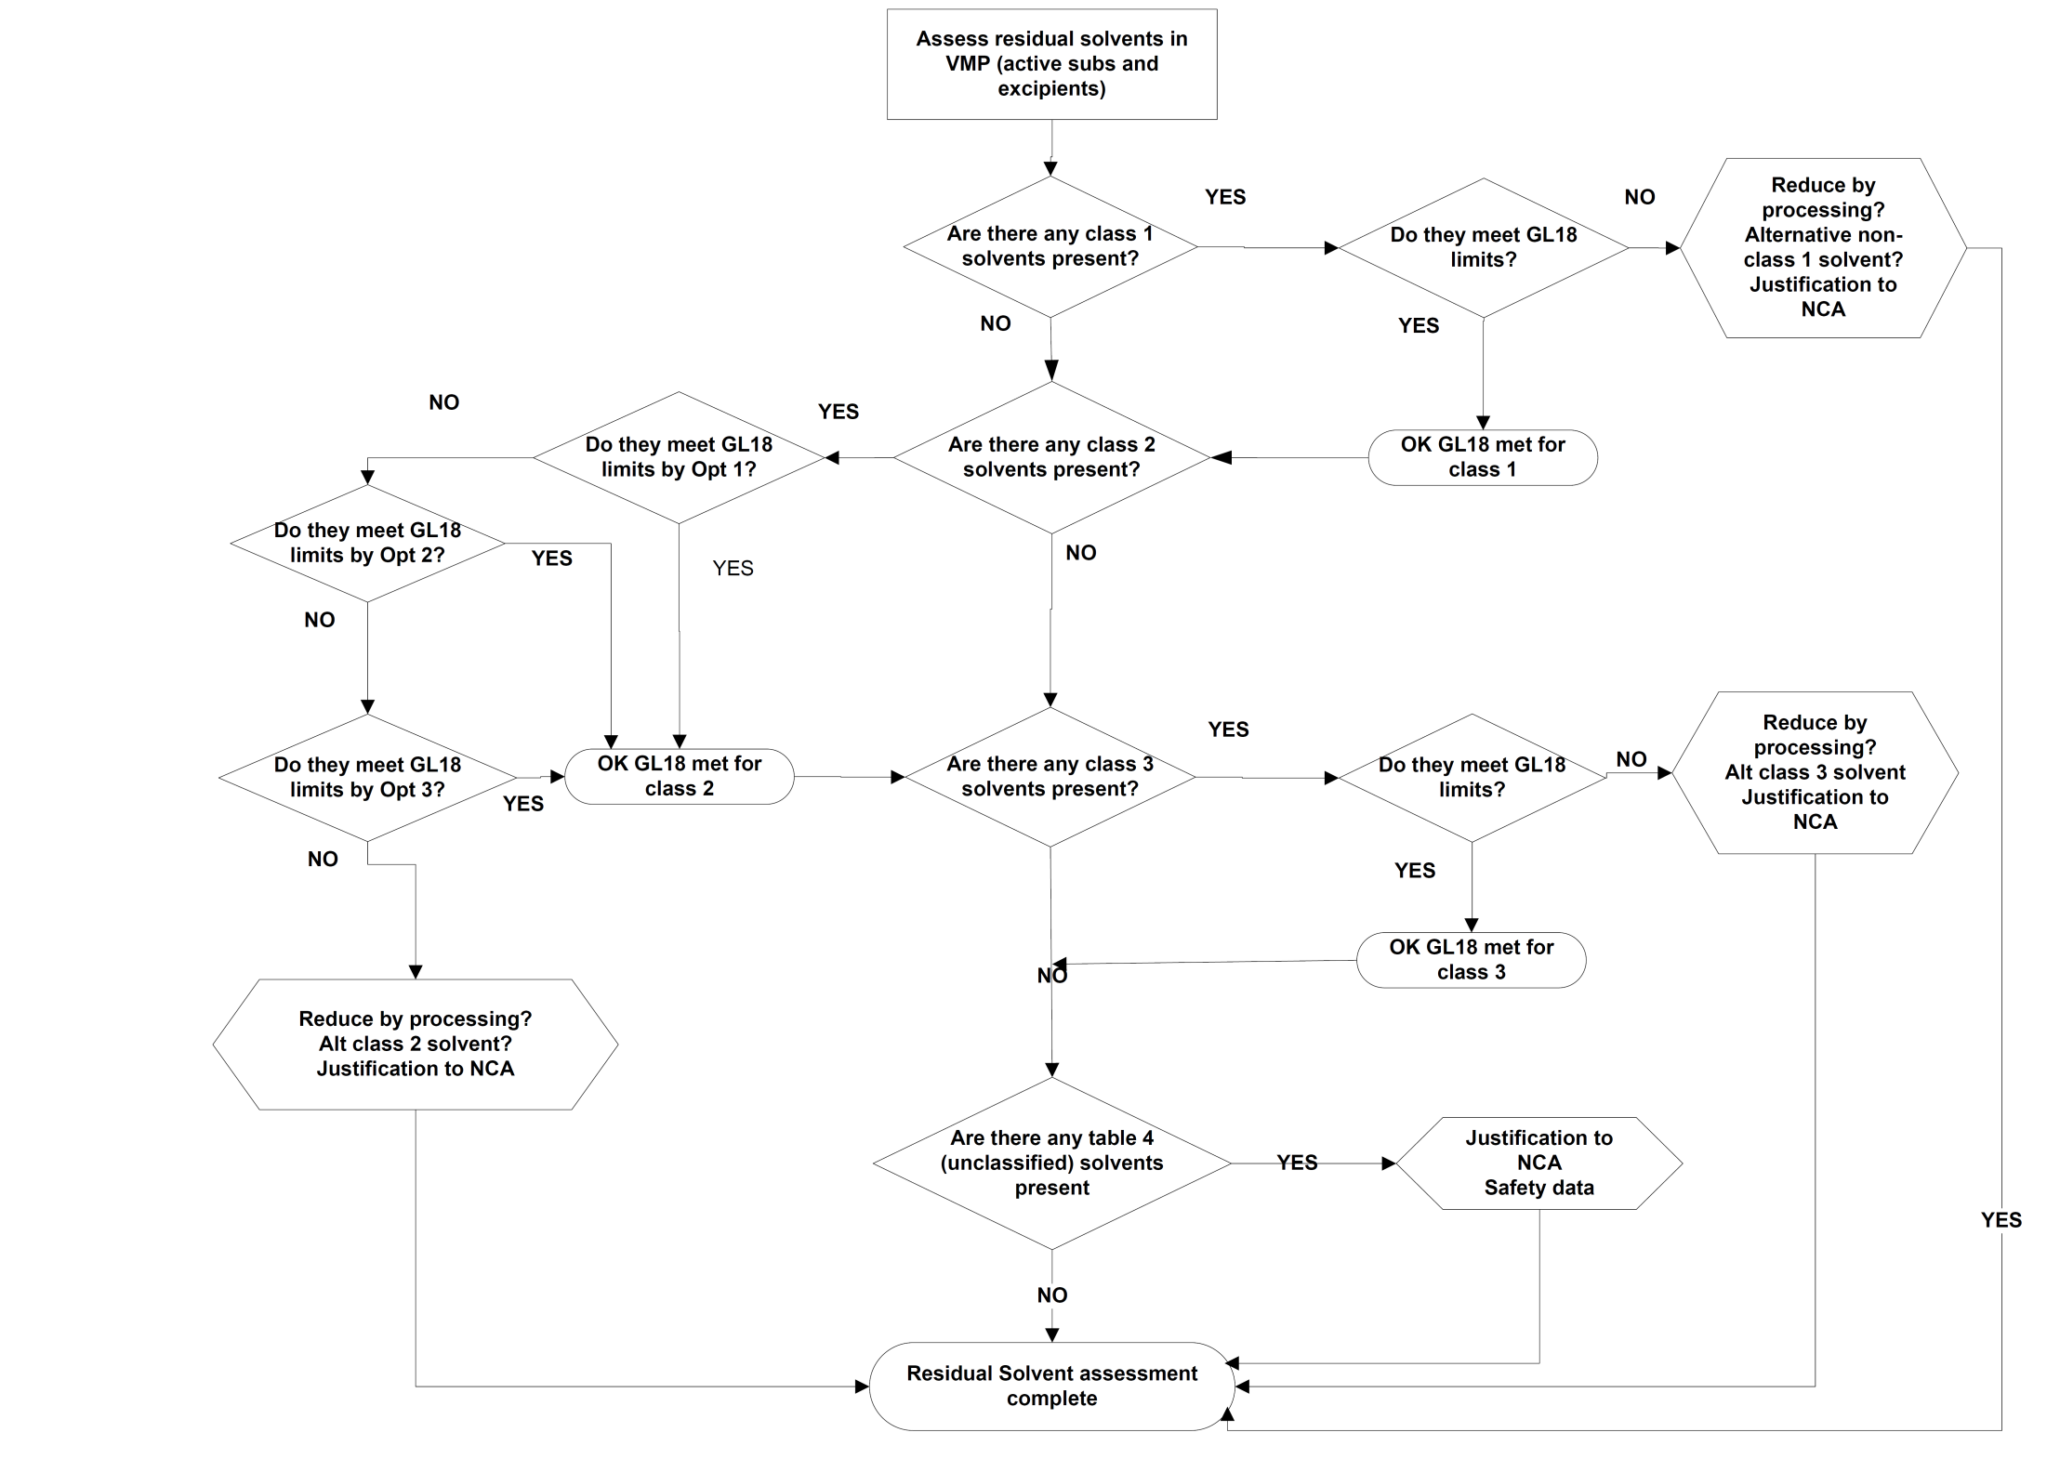
Flow chart for residual solvents assessment

